Slide 1
CSYE 7280 - User Experience Design and Testing
Instructor: Vishal Chawla

Slide 2
Software testing
Software testing is a process of executing a program or application with the intent of finding the software bugs.
It can also be stated as the process of validating and verifying that a software program or application or product:
Meets the business and technical requirements that guided it’s design and development
Works as expected
“Testing is a process rather than a single activity.”

Slide 3
Importance of software testing
https://www.youtube.com/watch?v=TDynSmrzpXw

Slide 4
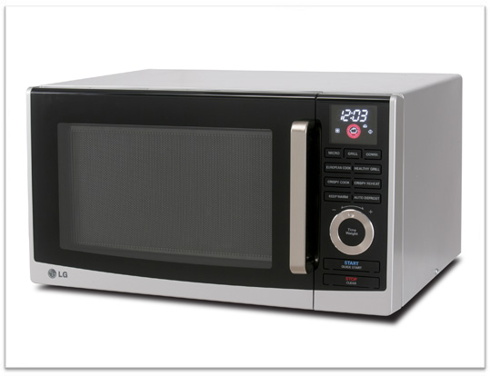
Test Product
How will you test this product?
There are no right or wrong answers, There is only Intuition- Tom ford

Slide 5
Objectives of software testing
Finding defects which may get created by the programmer while developing the software
Gaining confidence in and providing information about the level of quality
To prevent defects
To make sure that the end result meets the business and user requirements
To compile a record of software errors for use in error prevention
“Quality is never an accident; it is always the result of intelligent effort.” – John Ruskin

Slide 6
Black box and white box testing
Black box testing
White box testing
Black Box Testing is a software testing method in which the internal structure/ design/ implementation of the item being tested is NOT known to the tester
Mainly applicable to higher levels of testing: Acceptance Testing, System testing
In this sort of testing testers mainly focuses on the functionality of the system
Programming knowledge is not required.
Requirements specification will serve as the basis for designing test cases.
Implementation knowledge is not required to test
White Box Testing is a software testing method in which the internal structure/ design/ implementation of the item being tested is known to the tester
Mainly applicable to lower levels of testing: Unit Testing, Integration Testing
In this sort of testing developers mainly focuses on the structure means program/code of the system
Programming knowledge is required
Detail Design document will serve as the basis for designing test cases.
Implementation knowledge is required to test

Slide 7
Advantages and disadvantages of black box
Advantages
Unbiased tests because the designer and tester work independently
Tester is free from any pressure of knowledge of specific programming
Facilitates identification of contradictions & vagueness in functional specifications
Test is performed from a user’s point-of-view and not of the designer’s
Test cases can be designed immediately after the completion of specifications
Disadvantages
Tests can be redundant if already run by the software designer
Test cases are extremely difficult to be designed without clear specifications
Testing every possible input stream is not possible because it is time-consuming and this would eventually leave many program paths untested
Results might be overestimated at times
Cannot be used for testing complex segments of code

Slide 8
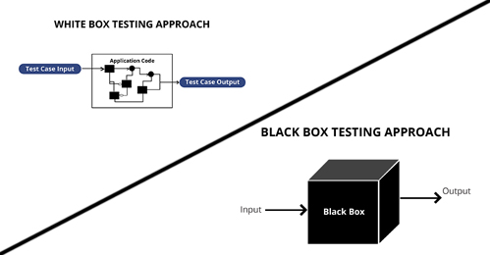
Advantages and disadvantages of White box
Advantages
Testing can be commenced at an earlier stage. One need not wait for the GUI to be available.
Testing is more thorough, with the possibility of covering most paths.
Ascertains quality of coding work and its adherence to coding standards.
Disadvantages
Since tests can be very complex, highly skilled resources are required, with thorough knowledge of programming and implementation.
Test script maintenance can be a burden if the implementation changes frequently.
Since this method of testing it closely tied with the application being testing, tools to cater to every kind of implementation/platform may not be readily available.

Slide 9

Testing Process
Determining the test methodology
Planning the tests
Designing the tests
Performing the tests
(implementation)
Test Reporting

Slide 10
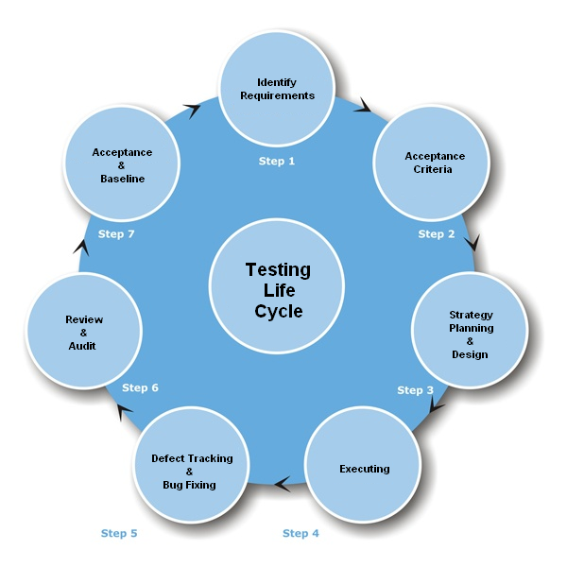
Software testing Life cycle

Slide 11
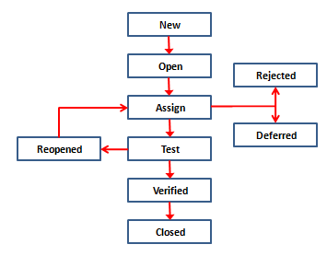
Defect Life cycle

Slide 12
Software test plan (STP) - Template
Scope of the tests
The software package to be tested (name, version and revision)
The documents that provide the basis for the planned tests
Testing environment
Sites
Required hardware and firmware configuration
Participating organizations
Manpower requirements
Preparation and training required of the test team

Slide 13
Software test plan (STP) – Template ..
Tests details (for each test)
Test identification/ Test objective
Cross-reference to the relevant design document and the requirement document
Test class/Test level (unit, integration or system tests)
Test case requirements
Special requirements (e.g., measurements of response times, security requirements)
Data to be recorded
Test Schedule
Preparation
Testing
Error Correction
Regression Tests

Slide 14
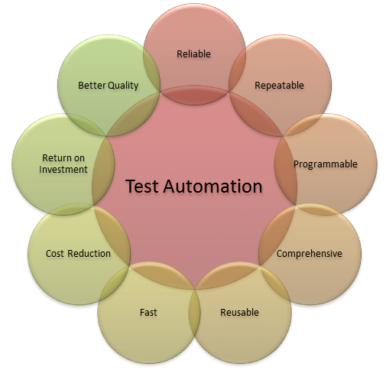
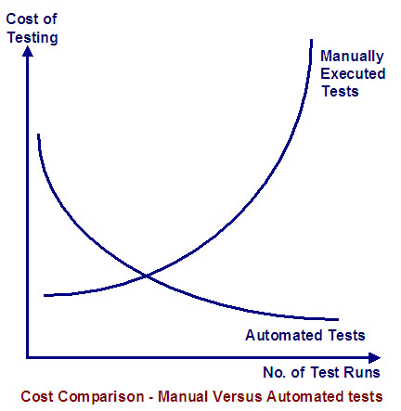
What is automation testing
https://www.youtube.com/watch?v=RbSlW8jZFe8
https://www.youtube.com/watch?v=ERmJO7R2CRs

Slide 15
Automation testing
TESTs that can BE AUTOMATED
Tests that need to be run with every build of the application (sanity check, regression)
Tests that use multiple data values for the same actions (data driven tests)
Complex and time consuming tests
Tests requiring a great deal of precision
Tests involving many simple, repetitive steps
Testing needed on multiple combinations of OS, DBMS & Browsers
Creation of Data & Test Beds
TEST That cannot BE AUTOMATED
Usability testing – “How easy is the application to use?”
One-time testing
“ASAP” testing – “We need to test NOW!”
Ad hoc/random testing – based on intuition and knowledge of application
Back-end testing

Slide 16
Manual vs automation Testing by phase
Testing Process Phase | Automation Testing | Manual Testing
Test Planning | M | M
Test Design | M | M
Preparing test cases | M | M
Performance of tests | A | M
Logs and test report preparation | A | M
Regression Tests | A | M

Slide 17
Test automation of web applications
Frequent regression testing
Rapid feedback to developers
Virtually unlimited iterations of test case execution
Support for Agile and extreme development methodologies
Disciplined documentation of test cases
Customized defect reporting
Finding defects missed by manual testing

Slide 18
Advantages and disadvantages of automation testing
Advantages
Accuracy and completeness of performance.
Accuracy of results log and summary reports.
Comprehensiveness of information.
Few manpower resources required for performing of tests.
Shorter duration of testing.
Performance of complete regression tests.
Performance of test classes beyond the scope of manual testing.
Disadvantages
High investments required in package purchasing and training.
High package development investment costs.
High manpower requirements for test preparation.
Considerable testing areas left uncovered.

Slide 19
type of testing to used ?
Depends on
Parts of application to be tested
User expectations
Time allowed for the project
Priorities set by manager
Defining the project boundaries
Source: www.seleniumhq.org

Slide 20
Testing tools
Open Source like Selenium, Junit, TestNG, Cucumber, watir, etc
Proprietary tools like IBM tools, HP Quality Manager, Tricentis Tosca tool, Quick Test professional, etc.,
Custom Created tools

Slide 21
Introduction to Selenium
Selenium automates browsers.
Primarily, it is for automating web applications for testing purposes, but is certainly not limited to just that. Boring web-based administration tasks can (and should!) also be automated as well.
Selenium has the support of some of the largest browser vendors.
Who have taken (or are taking) steps to make Selenium a native part of their browser. It is also the core technology in countless other browser automation tools, APIs and frameworks.
Source: www.seleniumhq.org

Slide 22
Selenium’s tool suite
Selenium IDE
Selenium Remote control (RC)
Selenium Webdriver
Selenium Grid

Slide 23
Selenium IDE
A Firefox add-on that will do simple record-and-playback of interactions with the browser
Create quick bug reproduction scripts
Create scripts to aid in automation-aided exploratory testing
Uses selenese commands
Convert Test cases to different Languages
Limitations
Selenium IDE is Firefox plugin, thus its support is limited to Firefox only
It will not support iteration and conditional statement
Selenium IDE doesn't support error handling
Selenium IDE do not support Database testing

Slide 24
Selenium RC
Allows you to write automated web application UI tests in any programming language against any HTTP website using any mainstream JavaScript-enabled browser.
Selenium RC comes in two parts.
A server which automatically launches and kills browsers, and acts as a HTTP proxy for web requests from them.
Client libraries for your favorite computer language.
Source: www.seleniumhq.org

Slide 25
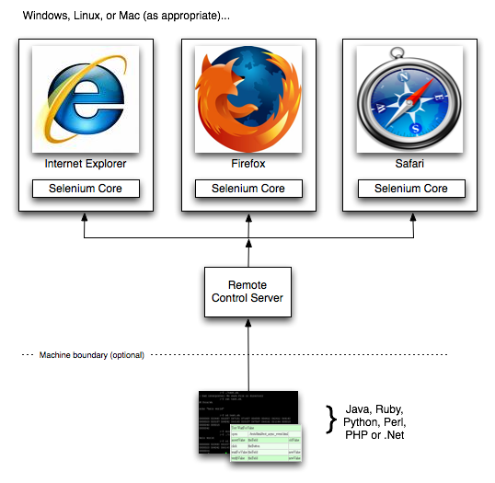
Selenium RC Representation
Source: www.seleniumhq.org

Slide 26
Selenium Web driver
Selenium web driver is in Version 2.0
Selenium Web driver API’s makes native API calls to the browser
Native automation is faster and less error prone
Does not require Selenium RC server
Can Operate headless browsers

Slide 27
Locators for selenium
Web element can be found in a web page by using as of the following element information
Id
Name
Link text
Partial link text
Tag name
Class name
Css
Xpath

Slide 28
Selenium Overview
Let’s go through a test script using Selenium Webdriver.

